Slide 1
Computer Networks
CSE3101 · Lecture 1 — Introduction & Motivation

Slide 2
Course Contents
Introduction, history, and development of computer networks
Layered architecture — the OSI Model and TCP/IP Model
Application Layer: basic communication applications and protocols
Transport Layer: services, protocols, and reliable protocol design
Network Layer: services, routing algorithms, addressing, sub-networks
Link Layer: channel access, addressing, interconnection devices
Physical Layer: physical media, data communication basics, line encoding
Wireless LAN, IEEE 802.11, 3G/4G, and Wireless Sensor Networks
Reference: Kurose & Ross — Computer Networking: A Top-Down Approach (6e)
Reference: Tanenbaum — Computer Networks (4e) · Forouzan & Mosharraf — Computer Networks: A Top-Down Approach

Slide 3
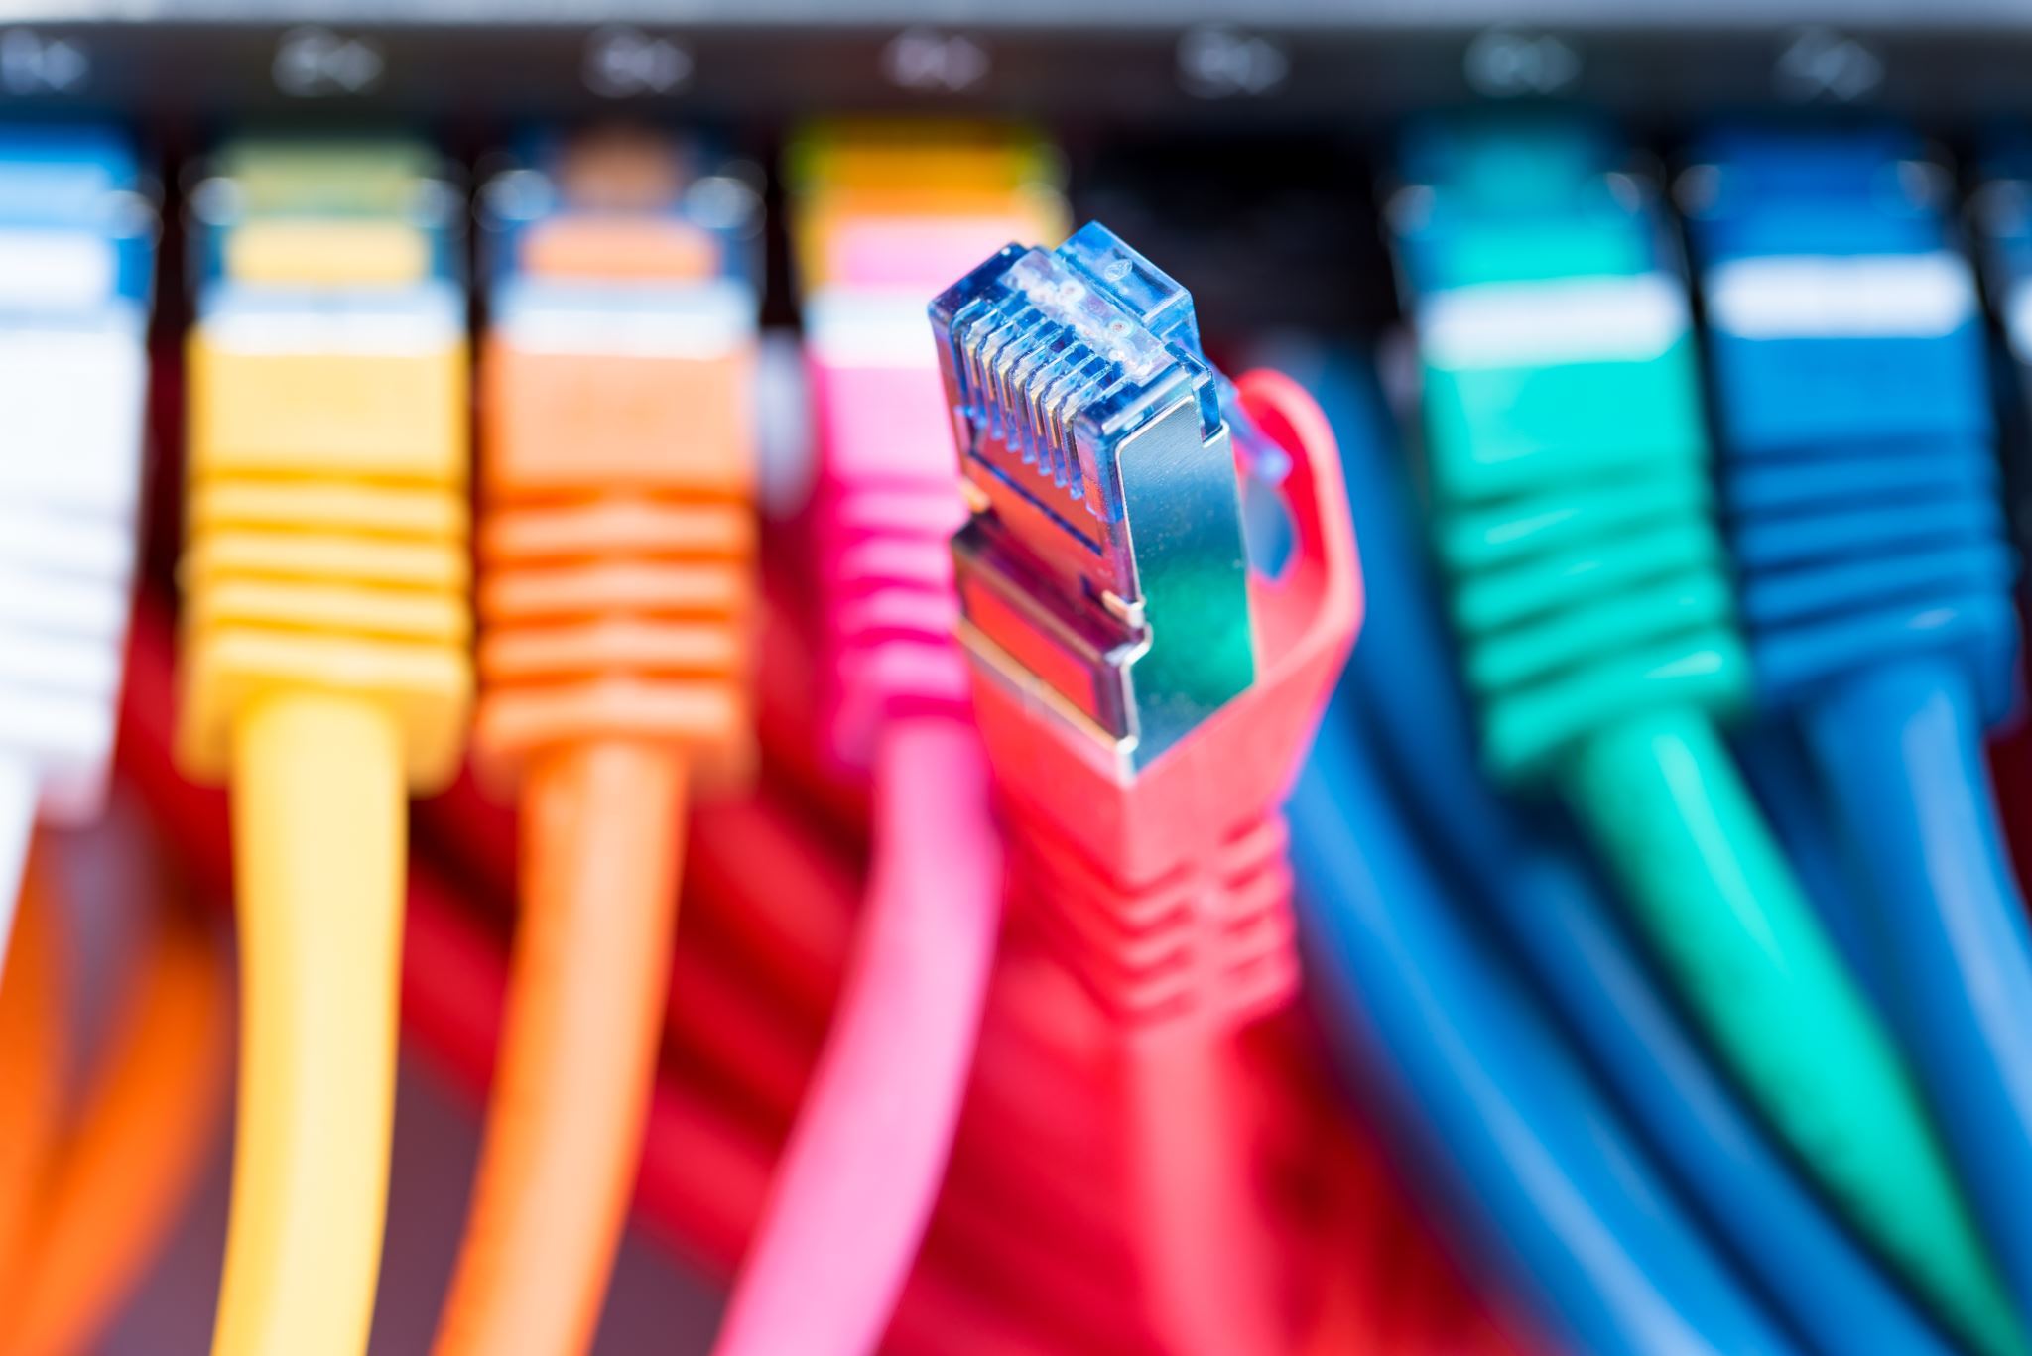
What Is a Computer Network?
A network is a set of devices (often called nodes) connected by communication links.
A node can be a computer, printer, or any other device capable of sending and/or receiving data.
A link can be a cable, air, optical fiber, or any medium that can carry a signal carrying information.

Slide 4
Layers of Identification on a Network
Network — identified using the Network ID (NetId)
Host — identified using the Host ID (HostId)
Process — identified using the Port Number
  Together, NetId + HostId form the device's IP address (e.g. 192.68.42.42)
Application-layer protocols such as DNS, HTTP, and SMTP operate on top of this addressing
  DNS converts a human-readable name into an IP address — this adds a small overhead

Slide 5

Network Criteria
Performance:
  Depends on the network elements involved
  Measured in terms of delay and throughput
Reliability:
  Failure rate of network components
  Measured in terms of availability and robustness
Security:
  Protecting data from corruption or loss due to errors or malicious users

Slide 6
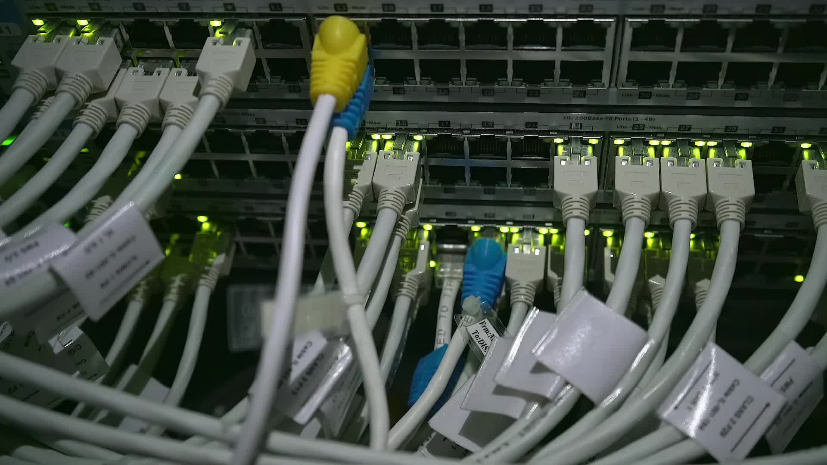
Type of Connection
Point-to-Point:
  A single transmitter and a single receiver
Multipoint:
  Multiple recipients share a single transmission
Physical Topology:
  How devices are physically connected to one another
Type of Transmission:
  Unicast — web browsing, email
  Multicast — online gaming, live webinars
  Broadcast — Wi-Fi setup, telecast

Slide 7

Protocol
A protocol is synonymous with a rule.
It consists of a set of rules that govern data communication.
It determines what is communicated, how it is communicated, and when it is communicated.
The key elements of a protocol are syntax, semantics, and timing.

Slide 8
Elements of a Protocol
Syntax
Structure or format of the data.
Indicates how to read the bits — field delineation.
Semantics
Interprets the meaning of the bits.
Knows which fields define what action.
Timing
When data should be sent, and at what speed —
and when it is expected to be received.

Slide 9
Motivation: The Information Economy
Today's economy is built not just on creating, distributing, and retailing goods —
— but increasingly on creating, distributing, and retailing information itself.
The future economy is likely to be dominated by information.

Slide 10
What Is Information?
Everyday information takes many forms: books, bills, CDs, and more.
It can exist in analog form (atoms) or digital form (bits).
Converting information from atoms to bits lets us use networks to move it — instead of moving physical atoms.
  This conversion is the foundation of modern data communication.

Slide 11
The Challenges
Represent all types of information as bits.
Move those bits:
  In large quantities
  Everywhere
  Cheaply
  Securely
  With guaranteed quality of service

Slide 12
Today's Networks Are Complex
Modern networks already involve many interconnected systems, protocols, and devices.
Tomorrow's networks will be even more complex.
This course's challenge: build a solid foundation for understanding how it all fits together — layer by layer.

